Slide 1


Principles and problems of de novo genome assembly
Karin Lagesen
Norwegian Veterinary Institute
and
Institute of Informatics, University of Oslo
Material adapted from slides provided by Lex Nederbragt

Slide 2
What is this thing called ‘genome assembly’?
Notes:
So, our first question is, what is actually a genome assembly?

Slide 3
What is a genome assembly?
A hierarchical data structure
that maps the sequence data
to a putative reconstruction of the target
Miller et al 2010, Genomics 95 (6): 315-327
Notes:
We can say that an assembly is a
Hierarchical data structure that
Maps the sequence data to a
Putative reconstruction of the target
But, what does that actually mean?

Slide 4
Hierarchical structure
reads
contigs
scaffolds
Notes:
So, this is what we mean with a hierarchical structure.
We have reads, from these reads we somehow create something we will call contigs, and these again are gathered into something called scaffolds.
Hierarchical structure here refers to that these are nested into each other, reads become contigs which become scaffolds.

Slide 5
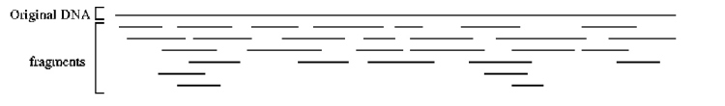
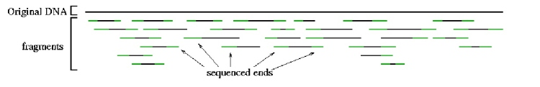
Sequence data
reads
contigs
scaffolds
Reads
original DNA
fragments
original DNA
fragments
Sequenced ends
http://www.cbcb.umd.edu/research/assembly_primer.shtml
Notes:
So, based on previous lectures, you know that reads stem from shotgun sequencing.
To recap, we take DNA, and we fragment it.
PUSH
We the sequence sort pieces of these fragments, in case of paired end reads, we get one read from each end of each fragment.

Slide 6
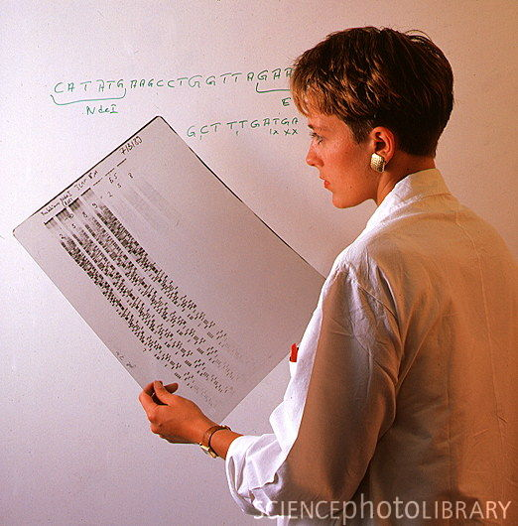
Reads!
reads
contigs
scaffolds
http://www.sciencephoto.com/media/210915/enlarge

Slide 7
Contigs
reads
contigs
scaffolds
Building contigs
Notes:
Ok, now that we have the reads sorted, we go on to contigs
What happens is that we take the reads, and we make a multiple alignment of them. That entails finding out where the reads overlap, where they are the same. From this multiple alignment we can get a consensus sequence, and this consensus sequence then becomes our contig.

Slide 8
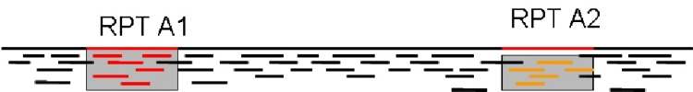
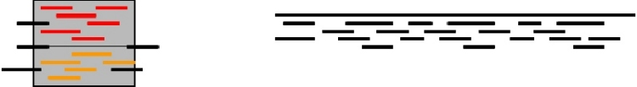
Contigs
reads
contigs
scaffolds
Building contigs
Repeat copy 1
Repeat copy 2
Contig orientation?
Contig order?
Collapsed repeat consensus
http://www.cbcb.umd.edu/research/assembly_primer.shtml
Notes:
Now, if everything was ideal, an assembly program should be able to reconstruct one contig for every chromosome of the genome that was sequenced. However, this usually doesn’t happen, quite frequently we get a lot of contigs.
Several factors here:
non-zero probability that there are regions of a chromosome that hasn’t been sequenced at all
Also un-evenness of sequencing along the chromosome – assembly programs like even and good coverage
However, biggest issue is repeats: PUSH
Regions of the genome that are identical or nearly identical
If reads are shorter than the regions, we have no way of sorting out which read belongs to which part of the sequence
Consequence: during assembly, these regions get collapsed – we get one contig with the repeat, and the other stuff in one or maybe more contigs.

Slide 9
Contigs
reads
contigs
scaffolds
Repeats: major problem
Repeat copy 1
Repeat copy 2
http://www.cbcb.umd.edu/research/assembly_primer.shtml
Notes:
So, the question then becomes, what can we do to alleviate this problem?
Question: If you look at this drawing, can you see any way of doing this? can any of you think of a way of doing that?

Slide 10
Mate pairs
reads
contigs
scaffolds
Other read type
Repeat copy 1
Repeat copy 2
(much) longer fragments
mate pair reads
Notes:
The answer is to in some way get hold of information that spans these regions, we need reads that stretches over the ga.
PUSH
If we have those reads, we could figure out where these repeats really belonged.
Two solutions for getting such reads:
Really long reads, as we will see later, or
Mate pairs: reads stemming from the ends of much longer fragments, fragments that span/cross over the repeat regions
With that info, we can figure out which reads go where.

Slide 11
Mate pairs
Paired end reads → 100-500 bp insert
original DNA
fragments
Sequenced ends
Mate pairs → 2-20 kb insert
Repeat copy 1
Repeat copy 2
mate pair reads
Notes:
Mate pairs work much in the same way as paired ends, only that the
PUSH
fragments that they stem from can be much longer
Not unusual that they are 2-20 kb long inserts

Slide 12
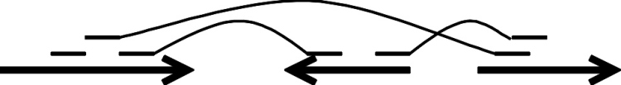
Scaffolds
reads
contigs
scaffolds
Ordered, oriented contigs
mate pairs
contigs
gap size estimate
Notes:
Ok, now on to scaffolds.
At the moment we have contigs, and we know all of the letters in each contig. Question becomes, is there a way to order these, to know which one is to the right or the left of another.
We can use both information found in the short reads, and also from long reads or mate pairs if we have them to try to do just that. We might be able to place a read at the end of two different contigs, and we can then theorize that these two contigs should be next to each other. Now, based on what we know about how long the fragment the reads come from, we can theorize about the number of bases that should be between them. Based on that we can put the two contigs after eachother, and insert “fake sequence”, i. e. Ns between them, as a placeholder showing that we know that there are X bases between them, we just don’t know what they are yet.

Slide 13
Hierarchical structure
reads
contigs
scaffolds
Notes:
So, there we have it. We have reads which come from fragmented DNA. We do a multiple assembly of these to get contigs, and we then use information found in the reads to order these contigs into scaffolds.

Slide 14
Assembly
How to do this?
Algorithms
Notes:
So, how do we do this? We use programs that are run by a computer, and these programs use different recipes, different algorithms to accomplish things.

Slide 15
Algorithms
All are graph-based
Node
Node
Edge, often directed
Graph-theory!
Notes:
Now, all of the algorithms that I will be talking about today are graph based.
What do these have to do with reads and assemblies?

Slide 16
Algorithms
All are graph-based
Read 1
Read 2
Overlap
Graph-theory!
Notes:
The trick here is that we can use these to assemble things because we can use these to figure out how reads are connected.
We can place our reads on the nodes in some way, and then we can say that reads are connected iff they have an overlap.
Since the data is now described by a graph, we can use graph algorithms to
PUSH create contigs

Slide 17
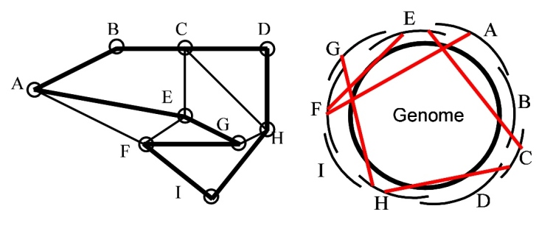
Algorithms
Hamiltonian path
a path that contains all the nodes
http://www.cbcb.umd.edu/research/assembly_primer.shtml
Notes:
So, how can this happen?
Let’s say we have a genome like this, with reads produced from this genome shown like lines outside of the genomes.
Now, as you see, we have overlaps betwen these reads, we can use that to create a circle, i.e. to recreate the genome.
However, the picture is complicated by parts of the genome being similar enough that we get false overlaps.
That would be the red lines.
PUSH
So, if we then look at this graph over here, this is how we would represent this same thing. Each node now represents a read, and the overlaps between them are edges between the nodes. The black lines are the overlaps that are «true», while the red ones are the false ones.
We can then reproduce the genome by traversing around this graph in such a way that we only visit each node, i.e. Each read once. This is called a hamiltonian paths.

Slide 18
Algorithms
Overlap calculation (alignment)
computationally intensive
Read 1
Read 2
Overlap
Notes:
However, it should be noted that this requires us to figure out where all reads overlap in order to align all the reads. That is a computationally expensive operation. We have to compare every single read to every other read.
However, if we do do that, we do get the alignments out

Slide 19
Algorithms
Path through the graph
→contig
Read 1
Read 2
Read 3
Read 4
Overlap
Overlap
Overlap
Notes:
In the end, what we get are reads connected by overlaps, and if we have long enough reads, we can actually have long range overlaps.
We can then use these to get aligned reads, that give contigs

Slide 20

Algorithms
Many flavors
Abandoned
→ Greedy extension
Two most used
Overlap Layout Consensus
de Bruijn graph
http://www.waialuasodaworks.com/images/flavors2009.jpg
Notes:
So, that was a short overview of how we conseptually can use graphs to assemble genomes.
However, there are several ways of doing this in practice.
The first way is what was called greedy extension, this one is now largely abandoned.
The two most used ones today are Overlap Layout Consensus, and the other is called a de bruin graph.
Note: both of these represent different ways to get a graph based on the reads. Once we have the graph, we can get contigs from it.

Slide 21
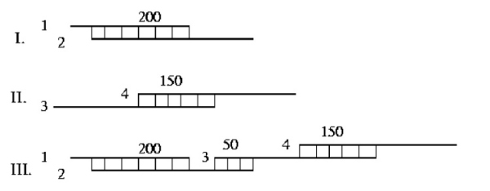
Greedy extension
Oldest
http://www.cbcb.umd.edu/research/assembly_primer.shtml
Notes:
The first assembly programs used a greedy extension approach. What they would do would be to find all overlaps between reads. It would then begin stitching them together, by first stitching the most similar reads together, and then working their way through the reads.
In this example, we first get 1 and 2 joined. Then, the next highest scoring one is 3 and 4. The next one after that is 2 and 4, which then stitches all four reads together.
However, this one gets very confused by repeats, and will give misassemblies.
Greedy assemblers - The first assembly programs followed a simple but effective strategy in which the assembler greedily joins together the reads that are most similar to each other. An example is shown in Figure 8, where the assembler joins, in order, reads 1 and 2 (overlap = 200 bp), then reads 3 and 4 (overlap = 150 bp), then reads 2 and 3 (overlap = 50 bp) thereby creating a single contig from the four reads provided in the input. One disadvantage of the simple greedy approach is that because local information is considered at each step, the assembler can be easily confused by complex repeats, leading to mis-assemblies.

Slide 22
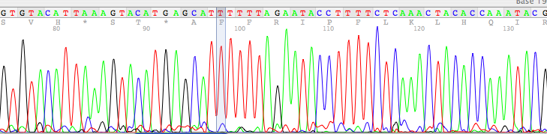
Overlap-Layout-Consensus
Typical for Sanger-type reads
also used by canu
Notes:
The next one is the OLC method, which we will use in this course in the form of the canu assembler.
This method was the first one that came into use, and is the methodology behind the Celera assembler, an assembler that was used to assemble the first human genome.

Slide 23
Overlap-Layout-Consensus
Steps
Overlap computation
Layout: graph simplification
Consensus: sequence
Notes:
This method has three steps, first we compute overlaps all against all
Then we put reads onto nodes and build a graph based on the calculated overlaps.
After that, we simplify the graph, and get a consensus.

Slide 24
Overlap-Layout-Consensus
Overlap phase:
K-mer seeds initiate overlap
K-mer: substring of length k from a longer string
ACGCGATTCAGGTTACCACG
Notes:
So, the fist thing we have to do here is to do go through an overlap phase. I mentioned this was very compute intensive. So we need to find a workaround.
The way we do this is by chopping the reads into smaller pieces, called k-mers. PUSH PUSH PUSH PUSH
For each k-mer, we make an index saying which reads contain that k+mer. This way we can pick out reads that are “similar enough” to start with and then compare those. That way we avoid comparing all against all
Comparing reads to see how similar they are is very expensive, however, seeing if two reads have the same k-mers, or words, in them is cheap.

Slide 25
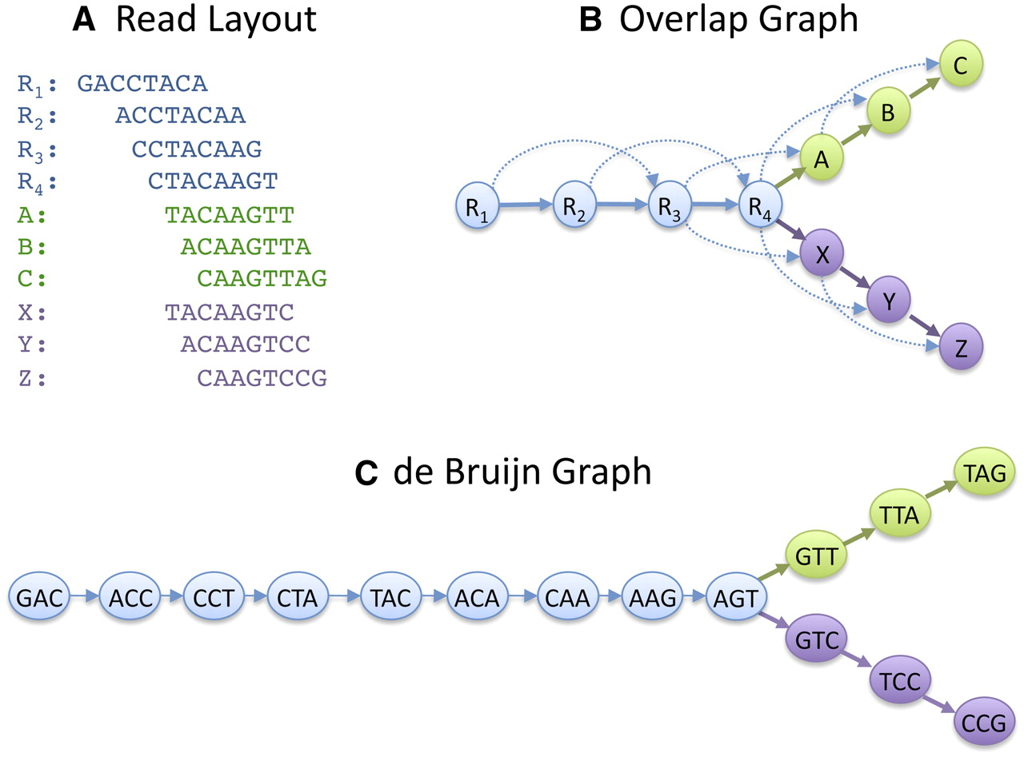
Overlap-Layout-Consensus
Schatz M C et al. Genome Res. 2010;20:1165-1173
Notes:
Once we have sensible overlaps, we can use those to lay out the graph.
We can follow this by looking here: We first have R1 that overlaps with R2 and R3, and R2 which overlaps with R3 and R4, and so on.
This gets interesting at R4, which overlaps with reads which don’t have the same ending.
R4 overlaps first with A, which overlaps with B and then C
R4 also overlaps with X, which overlaps with Y and then Z.
Now, at this point we have a graph, and we need to traverse it to get the contigs out.

Slide 26

de Bruijn graphs
Developed outside of DNA-related work
Best solution for short(er) reads
Read
GACCTACA
GAC
ACC
CCT
CTA
TAC
ACA
de Bruijn graph
K-mers (K=3)
GACC
GAC|
|ACC
K-1 bases overlap
Notes:
Ok, now I will explain the second way to produce a graph from we can get contigs. This is by using the reads to create de Bruin graphs.
These were introduced when short reads came on the market, and was pushed forward by the introduction of Illumina reads that were 50 to 100 nts long
In this case, we have a lot of reads, and they are short, so putting them into an overlap graph as before first means
1 Doing a lot of all against all comparions and
2. The graph will become very big
So, instead we build a different type of graph. What we do here is that we take the reads and we chop them up into smaller pieces, k-mers as I mentioned earlier.
PUSH We then build a graph from this, where each node in the graph overlaps with its neighbors with k-1 nucleotides.
PUSH Let’s look at these two to confirm, we are at the beginning of the sequence. The first node then contains GAC, and the next one contains ACC

Slide 27
Graphs
Schatz M C et al. Genome Res. 2010;20:1165-1173
Notes:
As before, we can then use this again to build the graph that we can get contigs from
In this case we get a different graph, but as you will see a bit later, this graph takes a lot less space in the memory of the computer

Slide 28
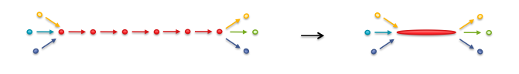
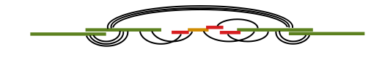
Graphs
Simplify the graph
Add scaffolding information
Notes:
So, in both cases, we now have a graph. To get the contings from this, we have to simplify the graph, and we need to add the scaffolding info to get the contiguity info we want.

Slide 29
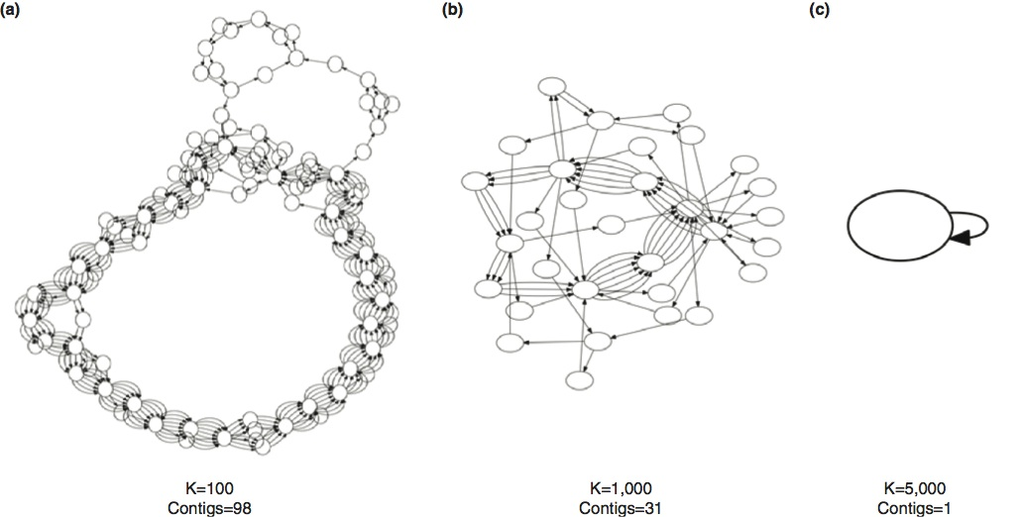
Read length matters
5.2 Mb circular genome, infinite error-free reads
Roberts et al (2013) doi:10.1186/gb-2013-14-6-405
Notes:
It should here be noted that the read length that we have matters a lot for the results that we get. Here, we have an idealized debruijn assembly graph of the genome Bacillus anthrasis Ames. I.e. here they took this genome and chopped it into pieces (i.e. no errors), and they build de bruijn assembly graphs from that. As we can see, the shorter the reads are, the more complex the graph gets.

Slide 30
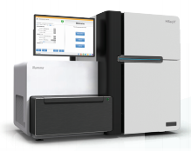
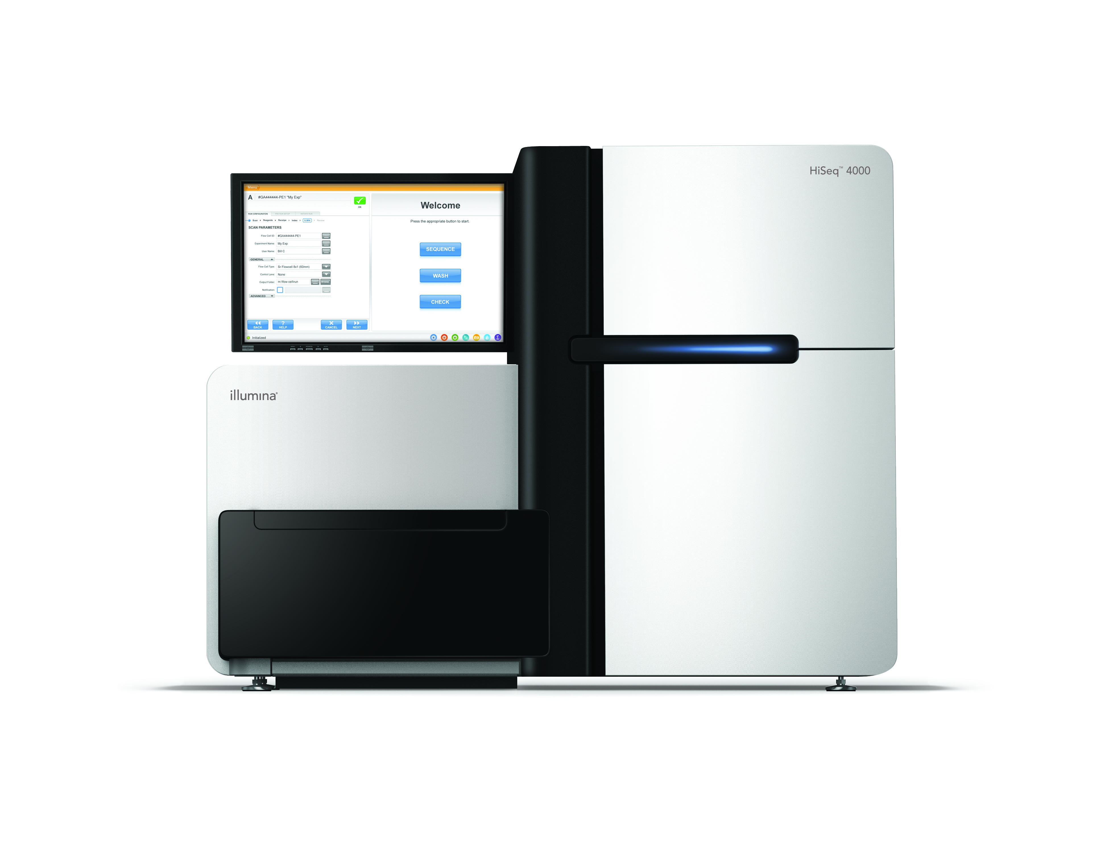
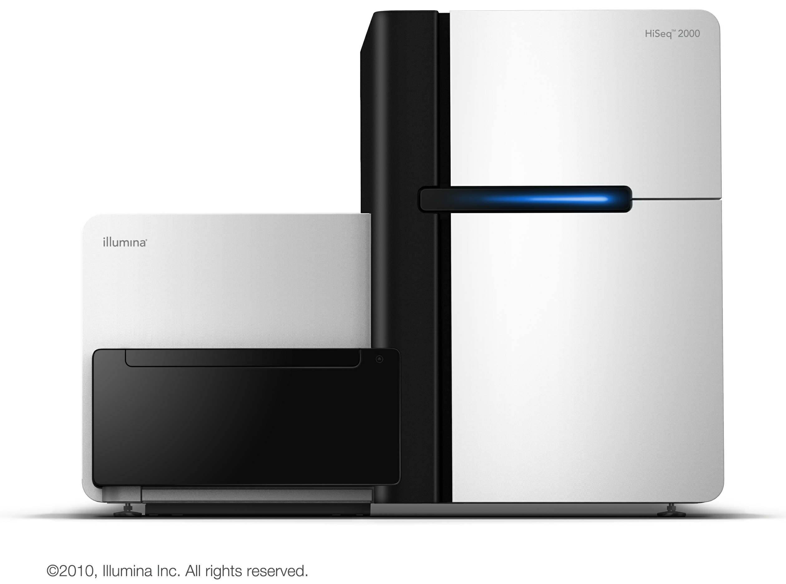
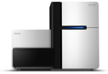
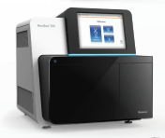
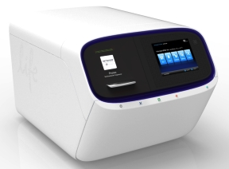
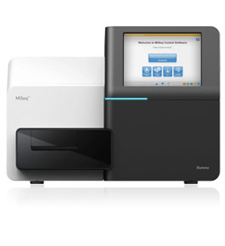

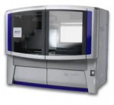
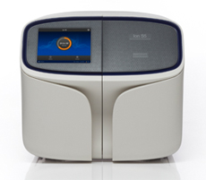
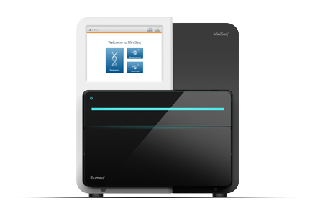
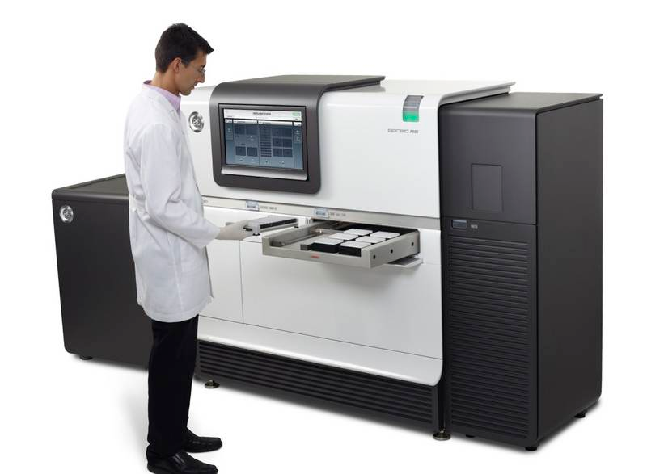
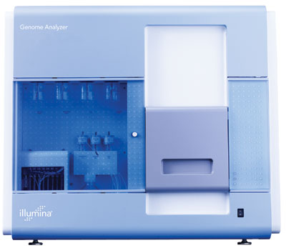
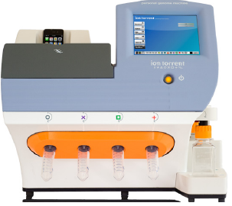
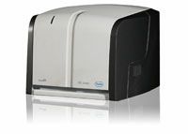
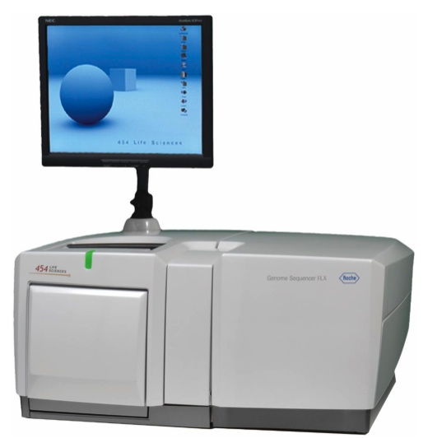
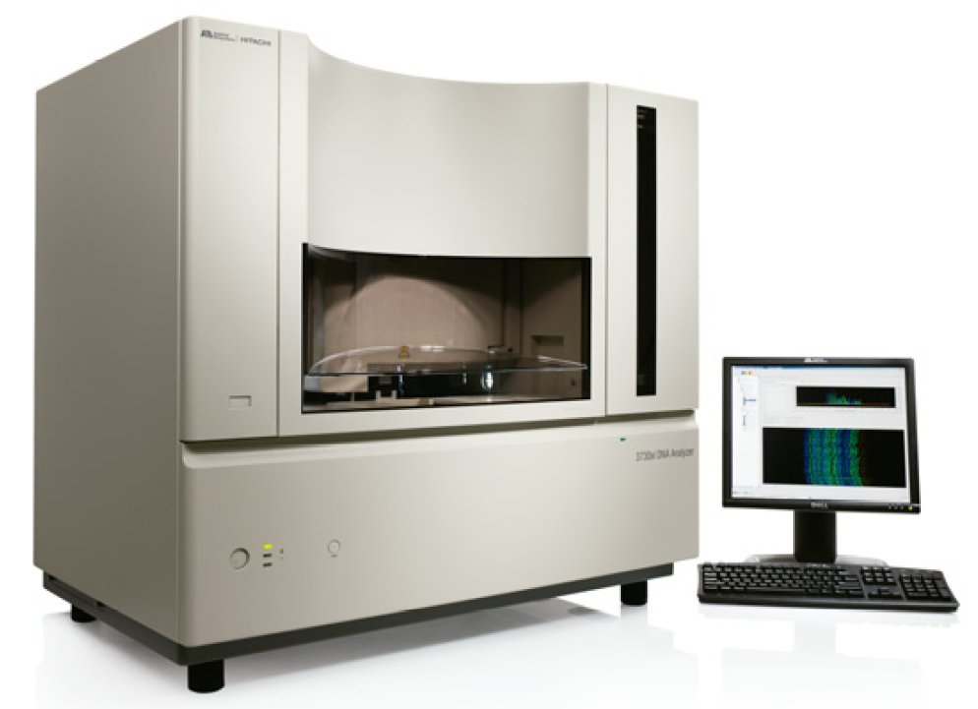

Developments in
High Throughput Sequencing
Hiseq X
Hiseq 4000
Hiseq
2000/2500
Hiseq2500 RR
NextSeq 500
Proton
MiSeq
MinION
SOLiD
S5/S5XL
MiniSeq
GA II
PGM
PacBio RS
GS Junior
GS FLX
‘Sanger’
Lex Nederbragt (2012-2016)
http://dx.doi.org/10.6084/m9.figshare.100940
Notes:
Now, the fortunate thing is that we now actually do have access to long reads.
This is a graph depicting the development of DNA sequencers the last couple of years.
X-axis: read length
Y-axis: how many bases we get out of it.
As you see here, this is where we find the first sequencer, the sanger sequencer. Long reads, but low output
Then we got the short read ones, with the GS FLX 454 machine being the first commercially successful ones
Then we got the illumina machines, which now dominate the market.
Now we’ve also started getting the long single molecule machines here, with pacbio and minion, these give very long reads, and as you can see, we get loads more output form them than the old sanger ones.

Slide 31
Developments in
High Throughput Sequencing
Hiseq X
Hiseq 4000
Hiseq
2000/2500
Hiseq2500 RR
NextSeq 500
Proton
MiSeq
MinION
‘Sanger like’
SOLiD
S5/S5XL
MiniSeq
GA II
PGM
PacBio RS
GS Junior
Long
Short
GS FLX
Intermediate
‘Sanger’
Lex Nederbragt (2012-2016)
http://dx.doi.org/10.6084/m9.figshare.100940
Notes:
Now, if we want to classify them, we thus get these categories

Slide 32
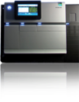
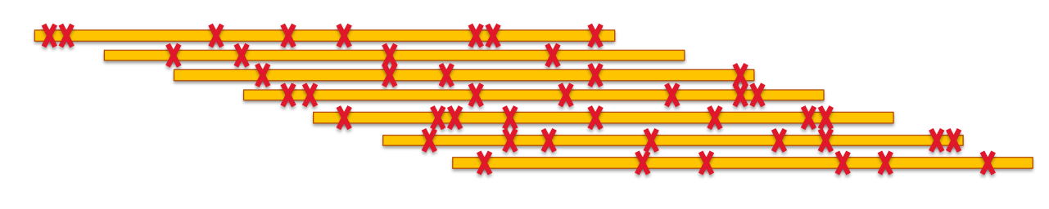
Quality matters
Too many errors → hard to find overlaps
http://schatzlab.cshl.edu/presentations/2012-01-17.PAG.SMRTassembly.pdf

Slide 33
Why is genome assembly such a difficult problem?
Notes:
Now, why is assembly really such a difficult problem?

Slide 34
1) Repeats
Repeat copy 1
Repeat copy 2
Repeats break up assembly
Collapsed repeat consensus
http://www.cbcb.umd.edu/research/assembly_primer.shtml
Notes:
The first one we’ve mentioned already, the repeat question. These break up the assembly since we can’t figure out where to put them.

Slide 35
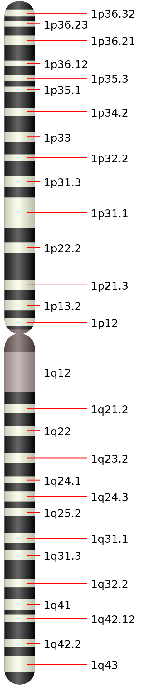
2) Diploidy
Differences between sister chromosomes
‘heterozygosity’
*
*
*
http://commons.wikimedia.org/wiki/File:Chromosome_1.svg
Notes:
The second problem is diploidy. We humans are diploid, with one chromosome each from our parents. However, these two aren’t completely PUSH identical. This complicates the assembly process

Slide 36
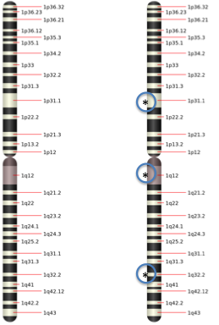
2) Diploidy
Polymorphic region 2
Region 1
Region 4
Polymorphic region 3
Homozygous
Heterozygous
Homozygous
Notes:
What we get, are polymorphic regions. These will for both methods give bubbles in the graph, and makes it more complicated to find the contigs and can break up the assembly. Depending on the level of heterozygosity, it can also be difficult to separate heterozygosity from errors in the sequenced reads.

Slide 37
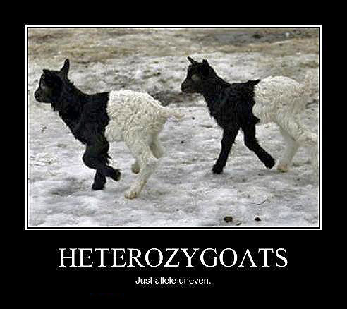
2) Diploidy
http://www.astraean.com/borderwars/wp-content/uploads/2012/04/heterozygoats.jpg
and many other sites

Slide 38
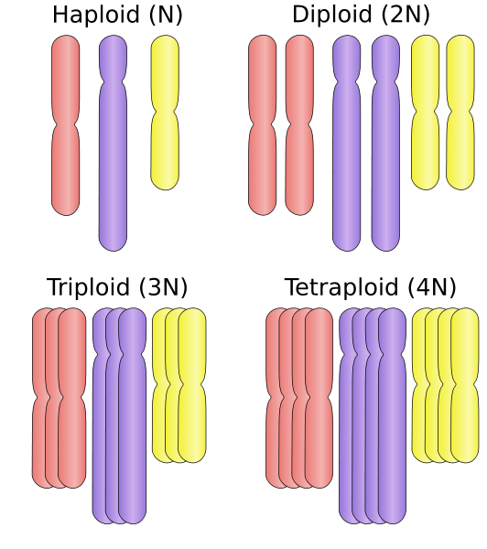
3) Polyploidy
http://en.wikipedia.org/wiki/Polyploidy
Notes:
We also have other organisms that have other prloidies.
An example is strawberries, which can have 2-7 copies of their genome. That makes it quite difficult to deal with.

Slide 39
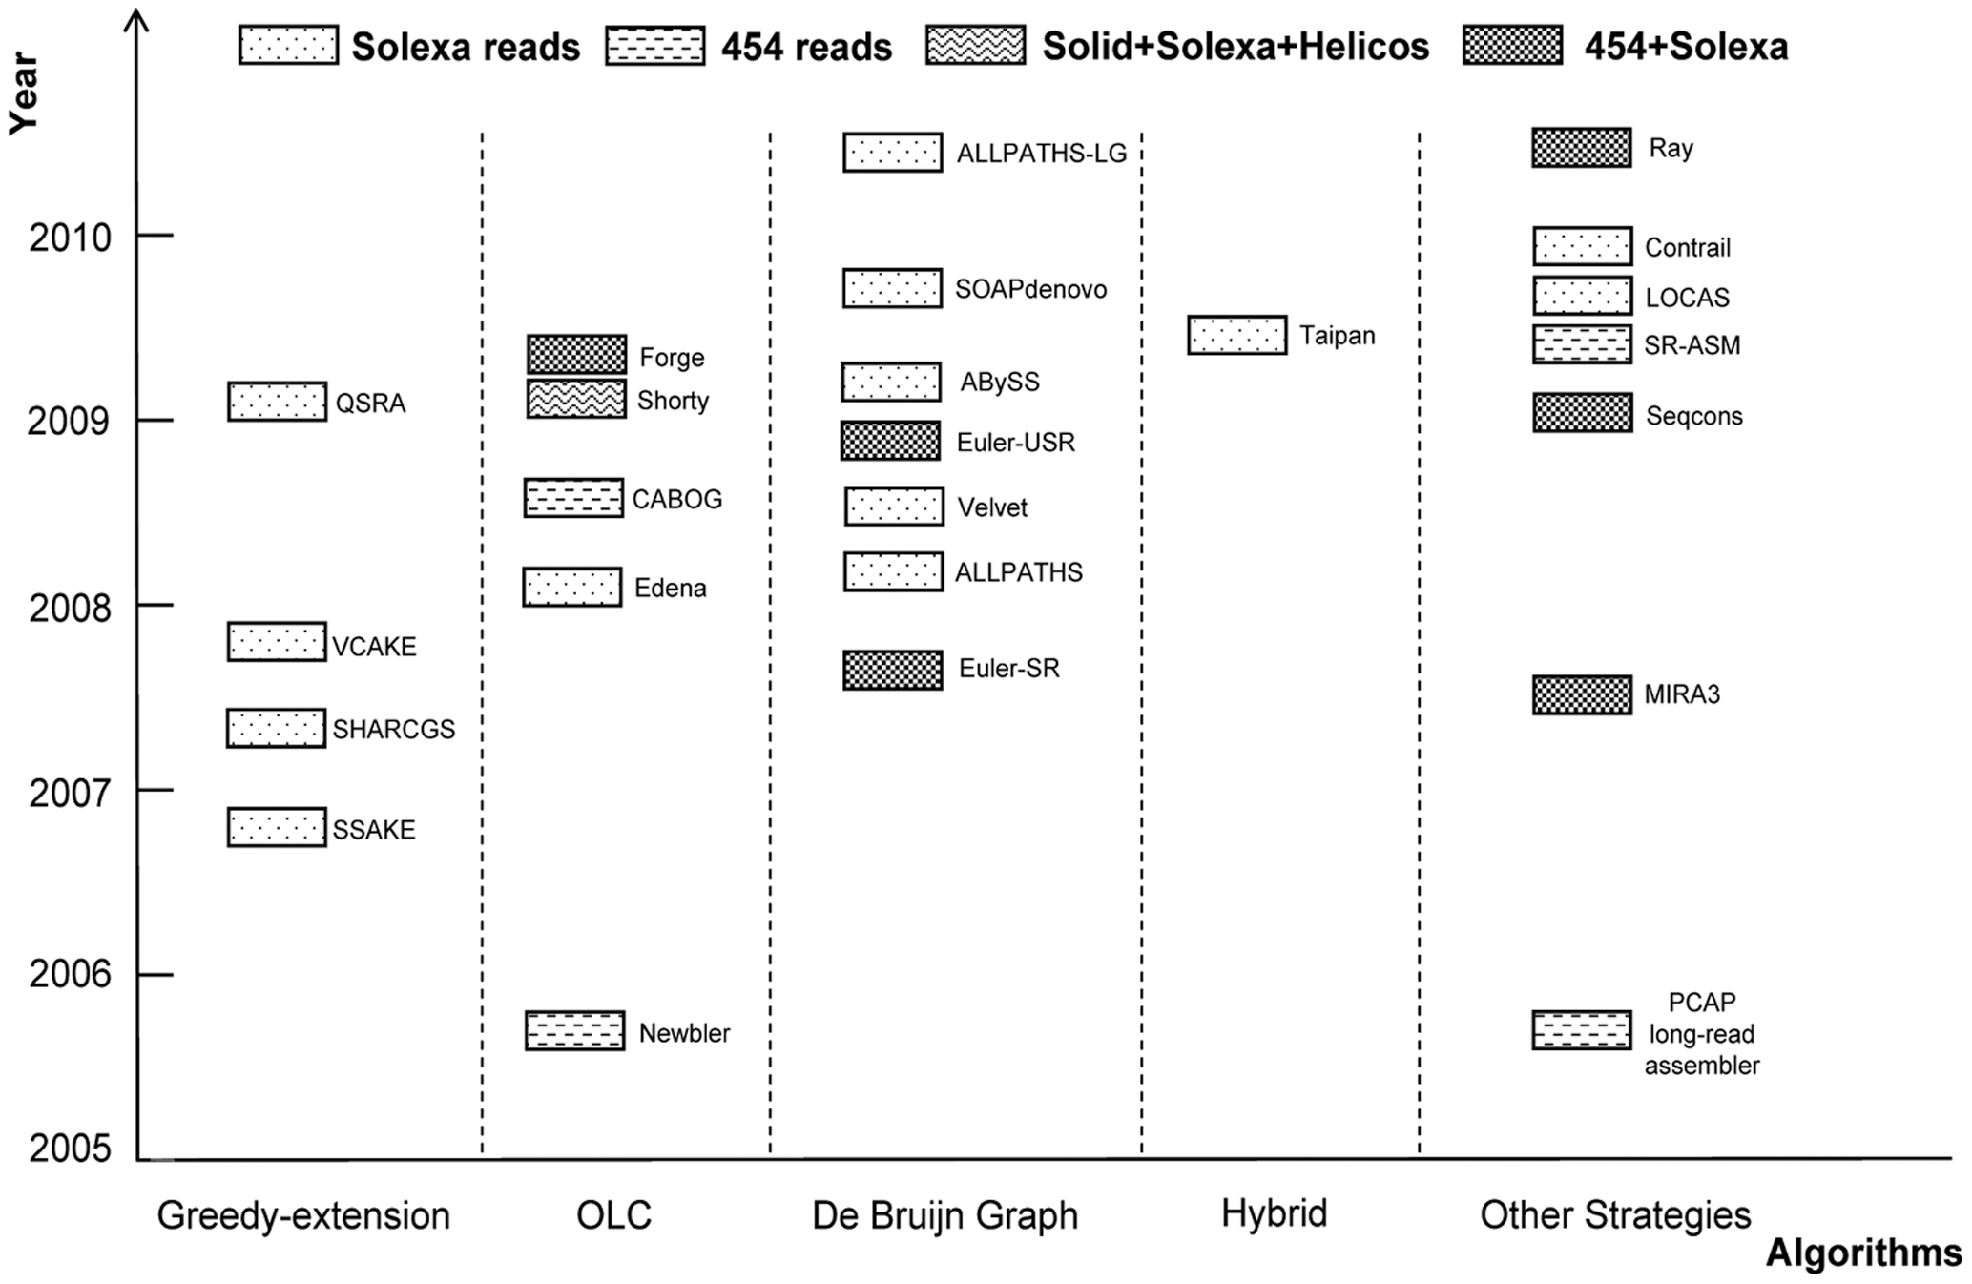
4) Many programs to choose from
Zhang et al. PLoSOne 2011
Notes:
Last but not least, there are lot of programs to choose from. Loads of different ways to do it.
It should also be noted that it has been shown that there is no one program out there that will always give the best results, no matter the dataset. That means that we need to try out multiple assemblers to see what will produce the best results on our data.

Slide 40
Assembly with noisy single molecule sequencing data
Notes:
Ok, now to something slightly different. As you saw, if we have longer reads, lots of our troubles are solved. However, this data is different than the data that we have dealt with so far, so we have to use different methods to deal with it.

Slide 41

Pacific Biosciences
Raw read quality
85-87% accuracy
Random errors (!)
4 to 5 passes: accuracies in the high 90's %
5 passes yields average Q30 (1:1000 chance of error)
Notes:
PacBio is the main producer of long read data today.
Pacbio: two ways of sequencing, Standard, and Circular Consensus.
Standard sequencing
– Long inserts so that the polymerase can synthesize along a single strand
PUSH
Circular consensus sequencing
– Short inserts, so polymerase can continue around the entire SMRTbell multiple
times and generate multiple sub-reads from the same single molecule.

Slide 42
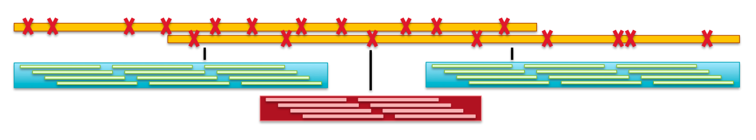
PacBio: long read uses
For de novo
For scaffolding
http://schatzlab.cshl.edu/presentations/2012-01-17.PAG.SMRTassembly.pdf
Notes:
Can use these reads in many ways, denovo and smart scaffolding the two most common ones
De novo assembly of SMRT-reads
– Use reads directly to assemble
– Long reads to span repeats
• Challenges
– 15% error rate per read equates to ~30% error rate per overlap
– CCS reads as shorter, but higher quality reads
PUSH
Smrt-Scaffolding
Have contigs from short reads
Use long reads (or strobe reads) to link high quality contigs from short reads
– Long reads (orange) span repetitive short-read contig (red)
– Doesn’t need very high coverage nor accuracy of long reads
• Challenges
– Creating good short read assembly
– Properly aligning reads to contigs
– Untangling complex repeats

Slide 43

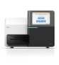
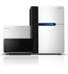
PacBio: error-correction
Raw read quality
85-87% accuracy
Random errors (!)
Error-correct using
PacBioToCA and other programs
Notes:
So, a big issue here is that the reads are error-prone
We can deal with that in one of two ways.
The first one is to use short read data to correct the long reads. We map the short reads onto the long reads and thus we get high quality long reads.

Slide 44
PacBio: error-correction
Raw read quality
85-87% accuracy
Random errors (!)
Using
this…
to error-correct
this
HGAP, Canu
doi:10.6084/m9.figshare.818957
Notes:
Option two depends only on long reads. For this we use the shorter reads in the data set to correct the longest ones. We have to use different mapping programs for this, because of the higher rate.

Slide 45
PacBio: HGAP, Canu
reads
contigs
scaffolds
http://www.nature.com/nmeth/journal/vaop/ncurrent/full/nmeth.2474.html
Notes:
Inspired by this we now have methods to create assemblies using only long read data, this follows what we would call a hierarchical approach.
Select the longest sequencing reads as a seeding sequence data set.
(2) Use each seeding sequence as a reference to recruit shorter reads, and preassemble reads through a consensus procedure.
(3) Assemble the preassembled reads using an off-the-shelf assembler that can accept long reads.
(4) Refine the assembly using all initial read data to generate the final consensus that represents the genome.

